Slide 1

Upgrading to dotnet core 3.1
And some of the random stuff that breaks – 06/11/2020

Slide 2


Slide 3
3 things that break – There are more
JSON.NET move causes timespan serialization to break
1
Pubternals have been removed
2
A whole host of EF related fun fun fun
3

Slide 4

JSON.NET move causes timespan serialization to break
.NET Core 3 moves away from JSON.NET and uses the new built in System.Text.Json for performance reasons.
This built in serializer has many flaws and gaps to be filled.
One of which is an inability to serialize TimeSpans.
Should be permanently fixed in v6.0

Slide 5
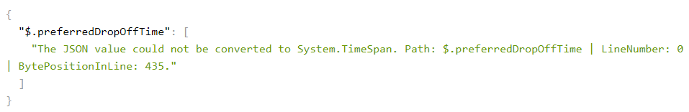
JSON.NET move causes timespan serialization to break

Slide 6
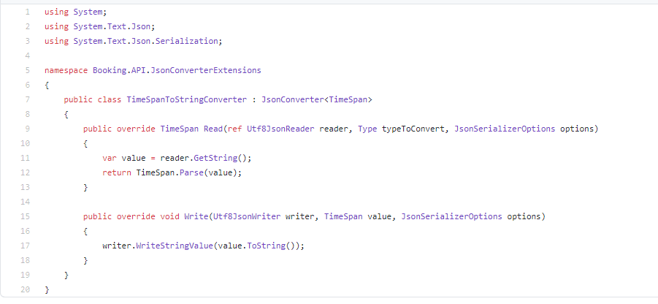
JSON.NET move causes timespan serialization to break - Solution
Create a custom timespan converter.

Slide 7
JSON.NET move causes timespan serialization to break - Solution
Register this custom timespan converter.

Slide 8

Pubternals have been removed
.NET Core was notorious for having “pubternal” APIS
These were public classes in an “internal” namespace
This access modifier has now been changed to internal
Meaning a lot of methods you were using now don’t exist

Slide 9






Aaah pub internals how we miss you

Slide 10
Some random examples of pubternals
All APIs in the Microsoft.AspNetCore.* and Microsoft.Extensions.* namespaces that have an Internal segment in the namespace name.
HttpContext.Request.EnableRewind(); → HttpContext.Request.EnableBuffering(); - read response stream many times
Collection.Join() → string.Join(",", Collection)
All APIs in the Microsoft.AspNetCore.* and Microsoft.Extensions.* namespaces that have an Internal segment in the namespace name.
https://docs.microsoft.com/en-us/dotnet/core/compatibility/2.2-3.1#pubternal-apis-removed

Slide 11
Pubternals have been removed - solution
Many of these “pubternal” classes have been given publicly encapsulated substitutes
Be this a direct lift and shit to a public namespace
Or a brand new method
If there’s not a new bit of code to fulfil your needs either hand craft one or open an issue up here https://github.com/dotnet/aspnetcore/issues

Slide 12

A whole host of EF related fun fun fun
Usually EF Core and .NET Core upgrades go hand in hand
If updating .NET Core in a project which has EF Core I’d usually upgrade both
Although the newest version of EF Core has some real fun issues
As you will see in the next slide… (yes made it to 4 points)

Slide 13
A whole host of EF related fun fun fun
Now these are not directly welded to a .NET Core upgrade, its just a good idea (in some cases) to keep the two pretty closely linked version wise.

Slide 14
A whole host of EF related fun fun fun
Here’s a couple examples of the fun fun fun:
LINQ queries are no longer evaluated on the client
EF Core 3.0 targets .NET Standard 2.1 rather than .NET Standard 2.0 - no more Framework mixing
The EF Core command-line tool, dotnet ef, is no longer part of the .NET Core SDK
Configuration API for owned type relationships has changed - WithOwner()
FromSql, ExecuteSql, and ExecuteSqlAsync have been renamed

Slide 15
A whole host of EF related fun fun fun - LINQ queries are no longer evaluated on the client
Before 3.0, when EF Core couldn't convert an expression that was part of a query to either SQL or a parameter, it automatically evaluated the expression on the client.
Starting with 3.0, EF Core only allows expressions in the top-level projection (the last Select() call in the query) to be evaluated on the client.
WHY? = Automatic client evaluation of queries allows many queries to be executed even if important parts of them can't be translated. This behaviour can result in unexpected and potentially damaging behaviour that may only become evident in production.
For example, a condition in a Where() call which can't be translated can cause all rows from the table to be transferred from the database server, and the filter to be applied on the client. This situation can easily go undetected if the table contains only a few rows in development, but hit hard when the application moves to production, where the table may contain millions of rows. Client evaluation warnings also proved too easy to ignore during development.

Slide 16
A whole host of EF related fun fun fun - LINQ queries are no longer evaluated on the client - example
var products = _context.Products.Where(p => CalculateTax(p.Price) > 100.0m);
This would break with EF Core 3.x as CalculateTax() cannot be transformed into SQL

Slide 17
A whole host of EF related fun fun fun - LINQ queries are no longer evaluated on the client - Example
The fix for this would be:
var products = _context.Products.Where(p => CalculateTax(p.Price) > 100.0m).ToList();

Slide 18
A whole host of EF related fun fun fun - LINQ queries are no longer evaluated on the client - Example
This is exactly what EF Core would’ve done before but it would have been implicit.
This means we can be more selective of when we load 1 million rows into memory
But means we would need to do a LOT of testing to ensure that we aren’t trying to run implicit client side evals with EF Core 3.x
https://compiledexperience.com/blog/posts/ef-core-client-side-eval

Slide 19
A whole host of EF related fun fun fun - LINQ queries are no longer evaluated on the client - Example
Id recommend adding the following:
This will throw an exception at development time (when running) when you are writing ef queries that lead to a client side eval that would fail.
This will hopefully prevent any NEW gremlins being added to production code
protected override void OnConfiguring(DbContextOptionsBuilder optionsBuilder) {
optionsBuilder.ConfigureWarnings(w => w.Throw(RelationalEventId.QueryClientEvaluationWarning));
}

Slide 20
A whole host of EF related fun fun fun
For the remainder please see
https://docs.microsoft.com/en-us/ef/core/what-is-new/ef-core-3.x/breaking-changes
They are ranked high to low severity

Slide 21

Good News
.NET 5 should be a bit more straightforward with mostly additive changes to fill in the gaps from .NET Core 3
Along with the deletion of some obsolete code
With that said there are still breaking changes which can be found here:
https://docs.microsoft.com/en-us/dotnet/core/compatibility/3.1-5.0

